Slide 1
1St Titchfield Sea Scouts River Hamble Expedition
An epic journey along the largely unexplored headwaters of the mighty Hamble
Saturday 9th July 2016

Slide 2
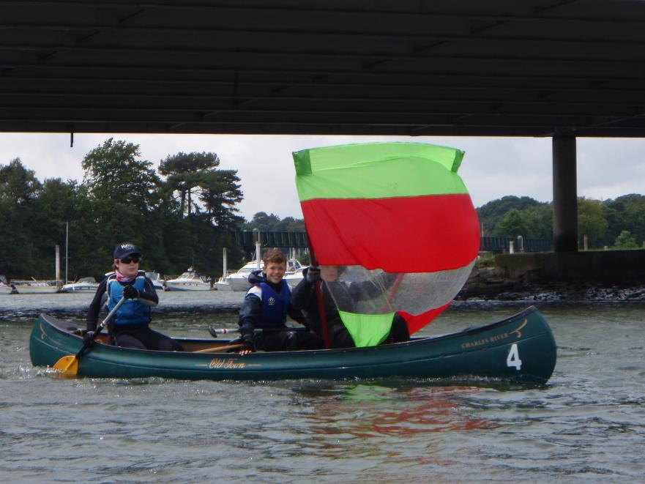
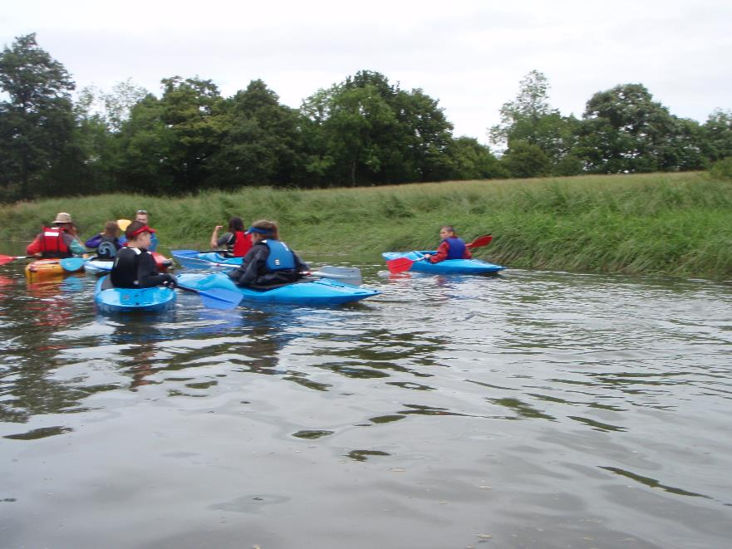
After an arduous paddle we start to leave civilisation behind….
Passing vast plains of rolling grassland……..

Slide 3
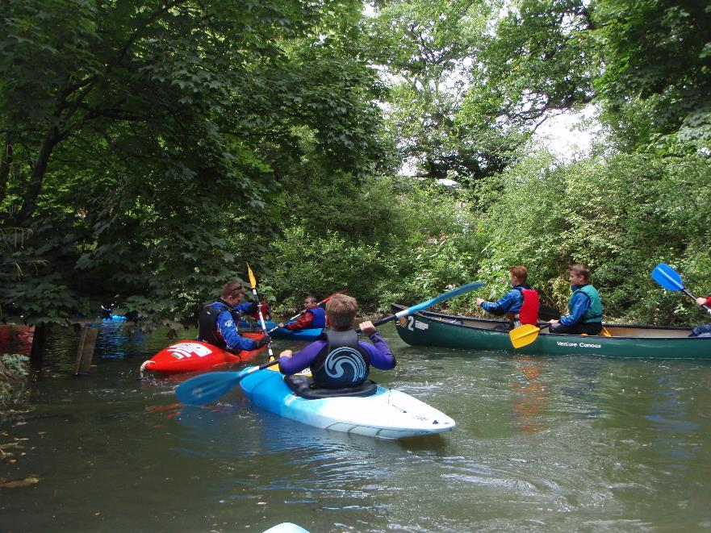
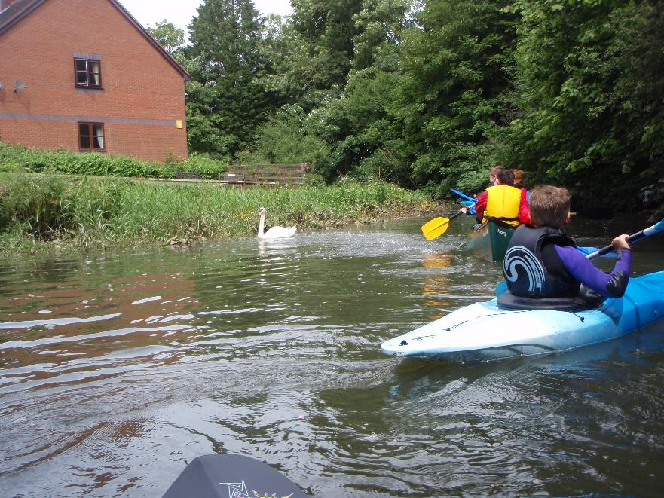
dense jungle….
& terrifying wildlife….

Slide 4
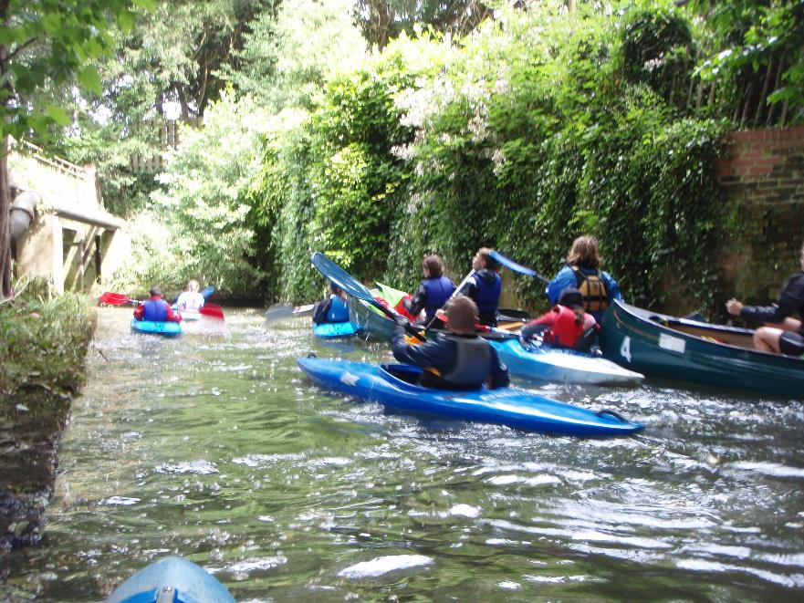
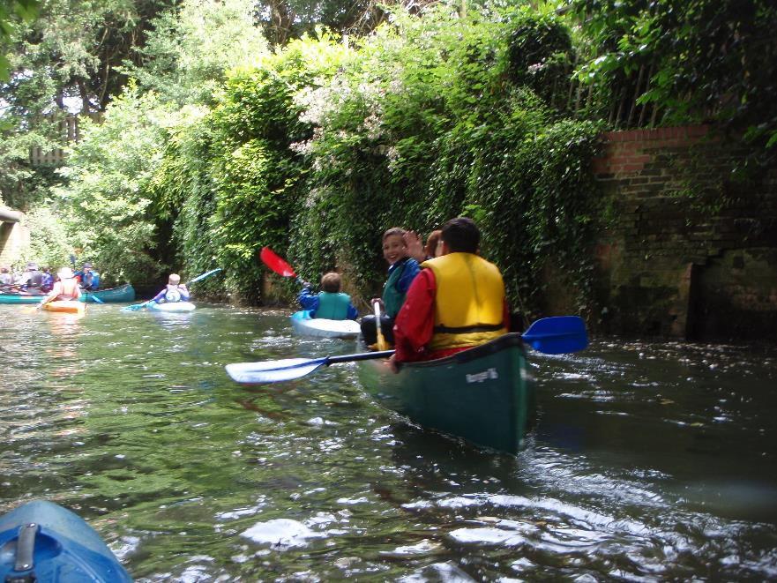
before plunging into an immensely deep gorge…..

Slide 5
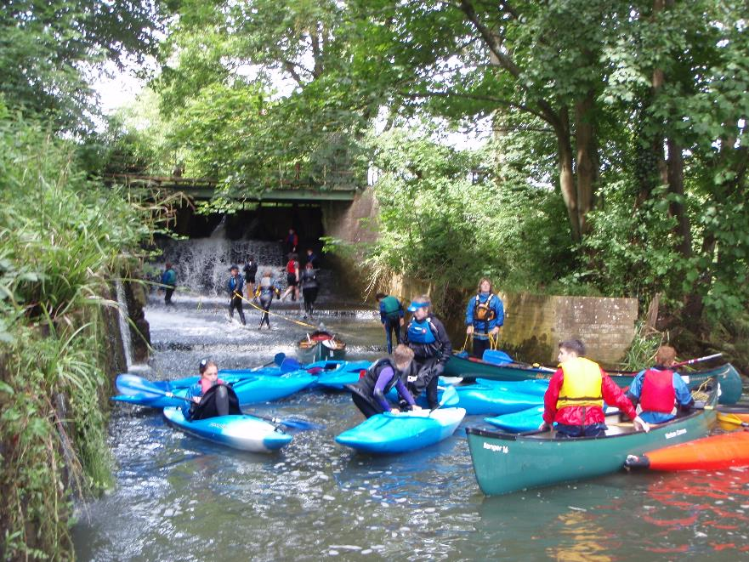
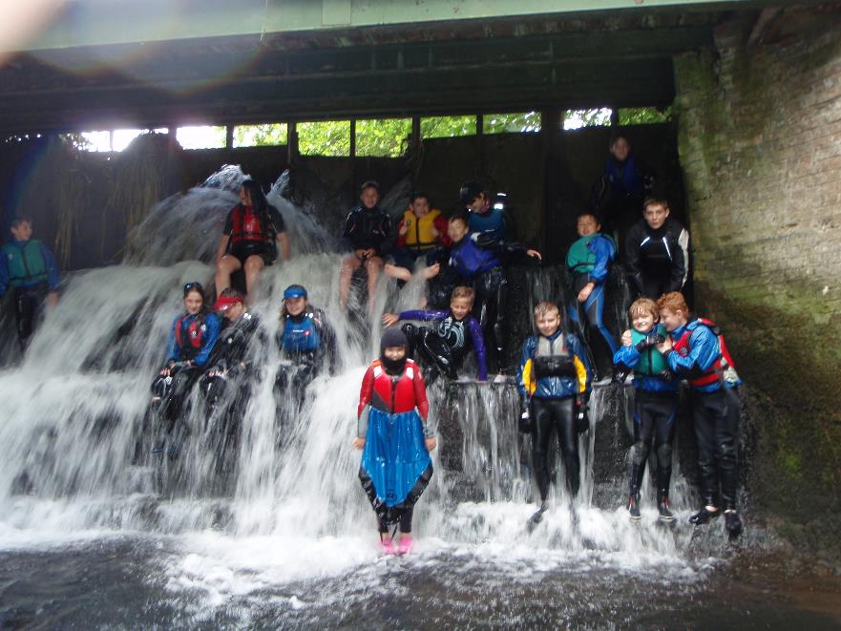
Leaving the boats for the final trek….
to the awesome Botley Falls,

